Slide 1
Flip Flops

Slide 2
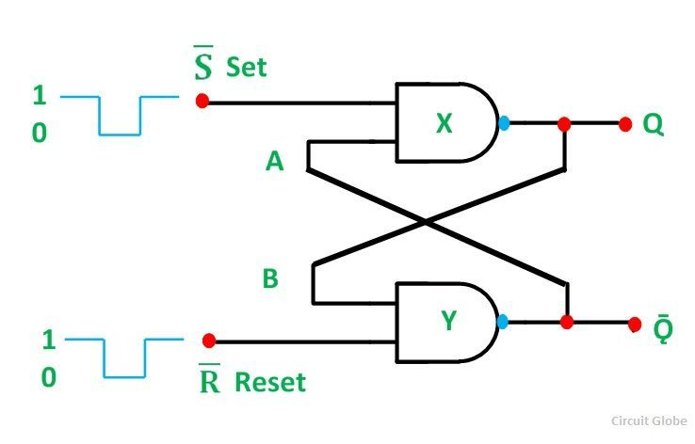
Set – Reset Latch

Slide 3
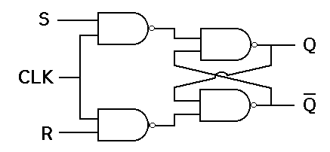
Clocked S-R Latch (S-R Flip Flop)

Slide 4
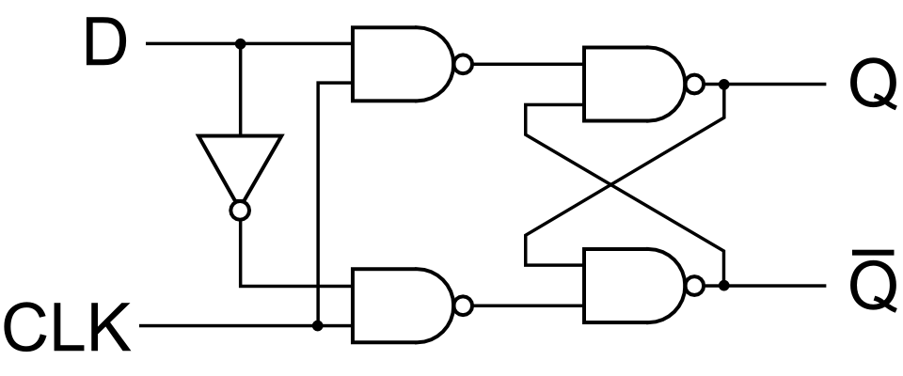
Clocked D-Flip Flop

Slide 5
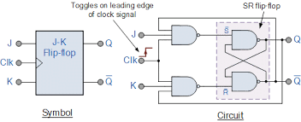
J-K Flip Flop

